Slide 1

AccuLedger: A Web-Based Accounting System
Minor Project-II Presentation
B.Tech CSE –D
Group-1
Raghav Kumar Jha(23010260)
Khushi Swarna(2301010228)
Ujjwal Prakash Singh(2301010234)

Slide 2
Introduction
AccuLedger is a user-friendly web-based accounting system.
Designed for small businesses, students, and professionals.
Simplifies tasks like income/expense tracking, invoicing, and reporting.

Slide 3
Motivation
Traditional accounting methods are error-prone and outdated.
Most existing tools are expensive or complex.
Need for a lightweight, accessible, and secure solution.

Slide 4
Objectives
Income and Expense Tracking
Ledger and Invoice Management
Exportable Reports and Charts
Secure Login and Responsive UI

Slide 5
System Architecture
Three-tier architecture: Client, Server, Database.
Technologies: PHP, MySQL, HTML/CSS, JavaScript, Bootstrap.
Data stored in structured MySQL tables.

Slide 6
Key Features
User Authentication
Income/Expense Tracker
Real-time Charts using Chart.js
Invoice Generation with PDF Export
Role-Based Access Control (future)

Slide 7

Implementation
Modular development using PHP and MySQL.
Bootstrap for responsive UI.
Chart.js and FPDF used for visualizations and reports.
Tested on Windows & Linux with XAMPP.

Slide 8
Results & Discussion
Validated all core features through sample data.
Responsive across devices, error rate <1%.
Compared favorably to manual and commercial tools.

Slide 9
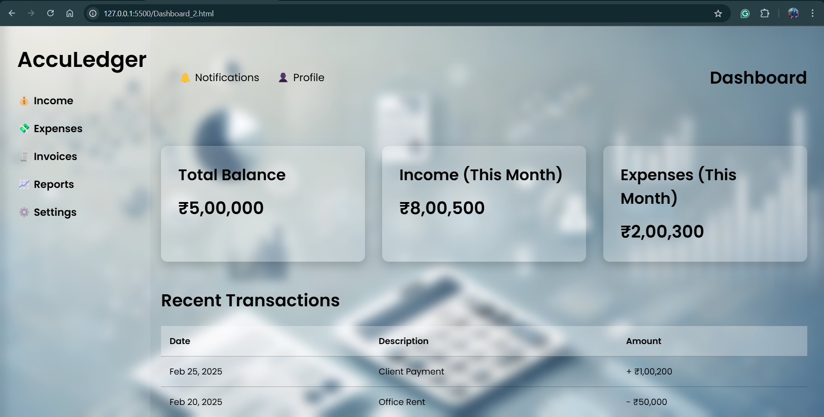

Slide 10
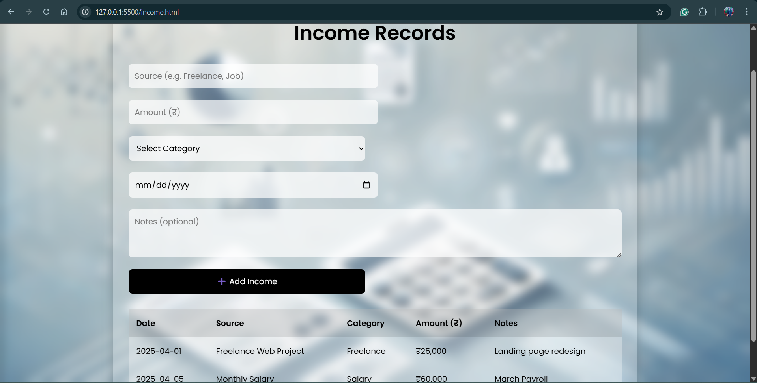

Slide 11
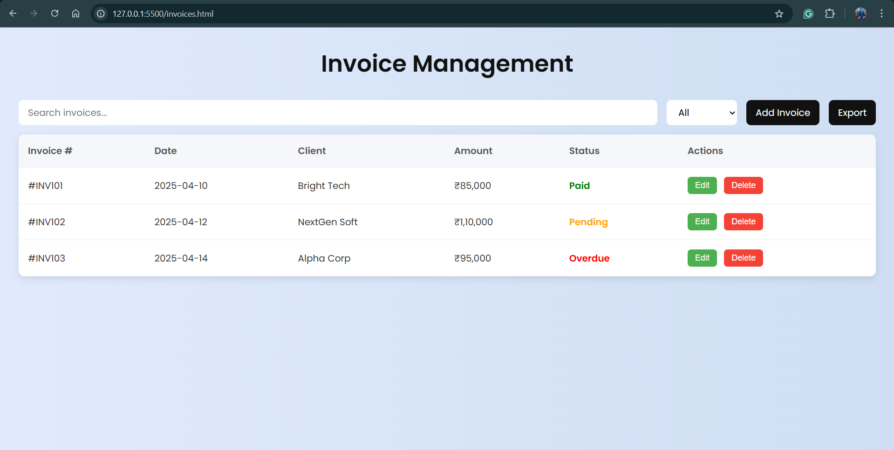

Slide 12
Future Work
Multi-role access system (Admin, Accountant, Viewer).
GST auto-calculation and advanced filtering.
Bank API integration and mobile app version.
Cloud hosting for global accessibility.

Slide 13

Conclusion
AccuLedger is a cost-effective and scalable solution.
Bridges the gap between manual and complex systems.
Democratizes financial management for small users.

